Slide 1
Thyroid disease classifications using machine learning

Slide 2
Team Members
Swetha
Keerthana
Selvarani
Janaki
Thenmozhi

Slide 3
Introduction
Thyroid disease is a subset of endocrinology which is one of the most misunderstood and undiagnosed diseases [1] [2]. Thyroid gland diseases are among the most prevalent endocrine disorders in the world, second only to diabetes, according to the World Health Organization. Hyper function hyperthyroidism and hypothyroidism affect about 2% and 1% of individuals, respectively. Men have about a tenth of the prevalence of women. Hyper-and hypothyroidism may be caused by thyroid gland dysfunction, secondary to pituitary gland failure, or tertiary to hypothalamic malfunction. Due to dietary iodine deficiency, goiter or active thyroid nodules may become prevalent in some regions, with a prevalence of up to 15%. The thyroid gland can also be the location of different kinds of tumors and can be a dangerous place where endogenous antibodies wreak havoc (autoantibodies) [3].

Slide 4
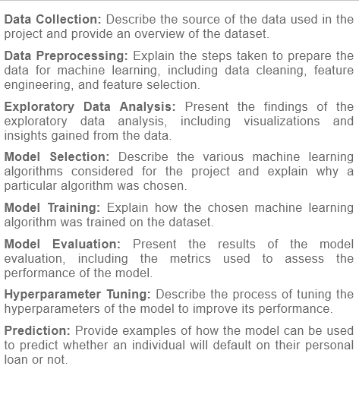
Machine Learning

Slide 5
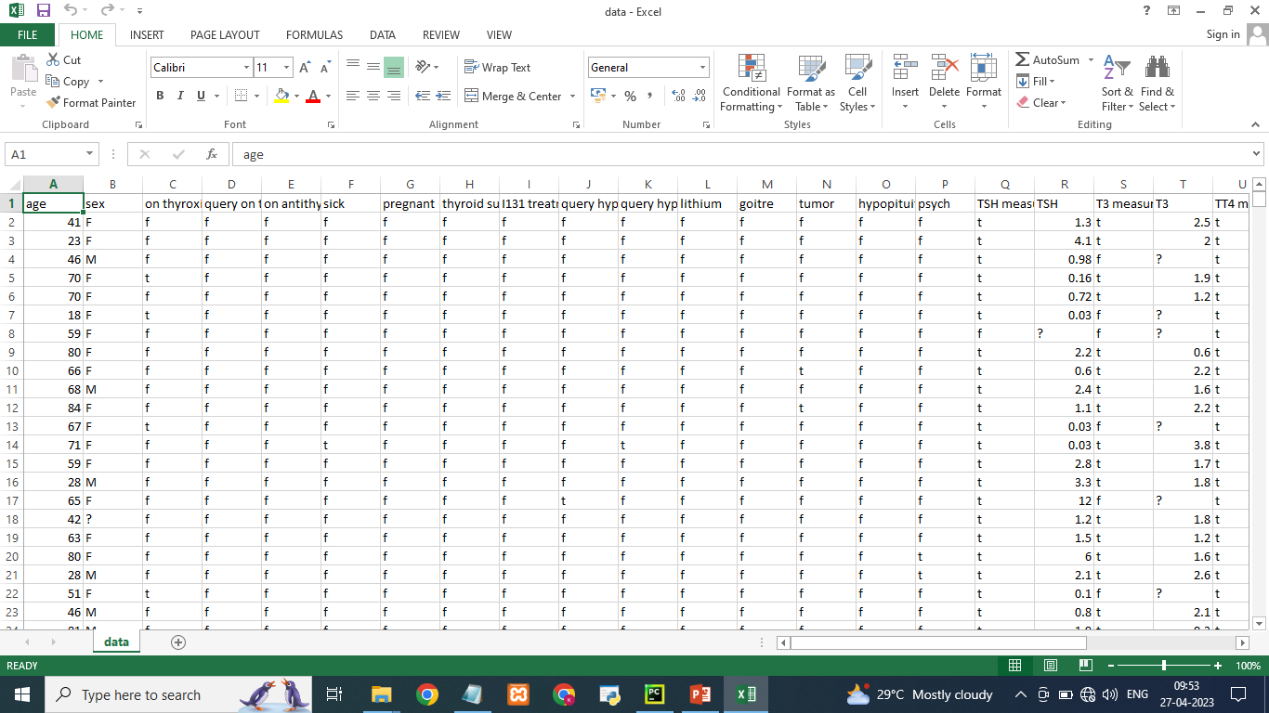
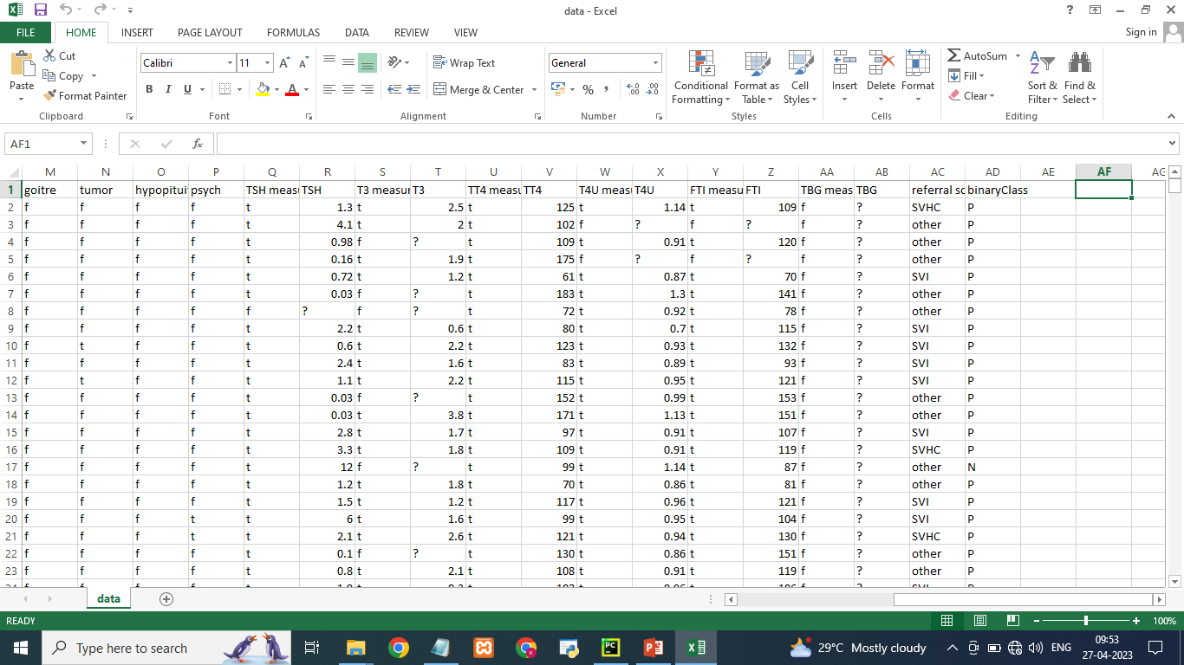
Dataset: In this project we have used .csv data. This data is downloaded from kaggle.com. Please refer to the link given below to download the dataset.

Slide 6
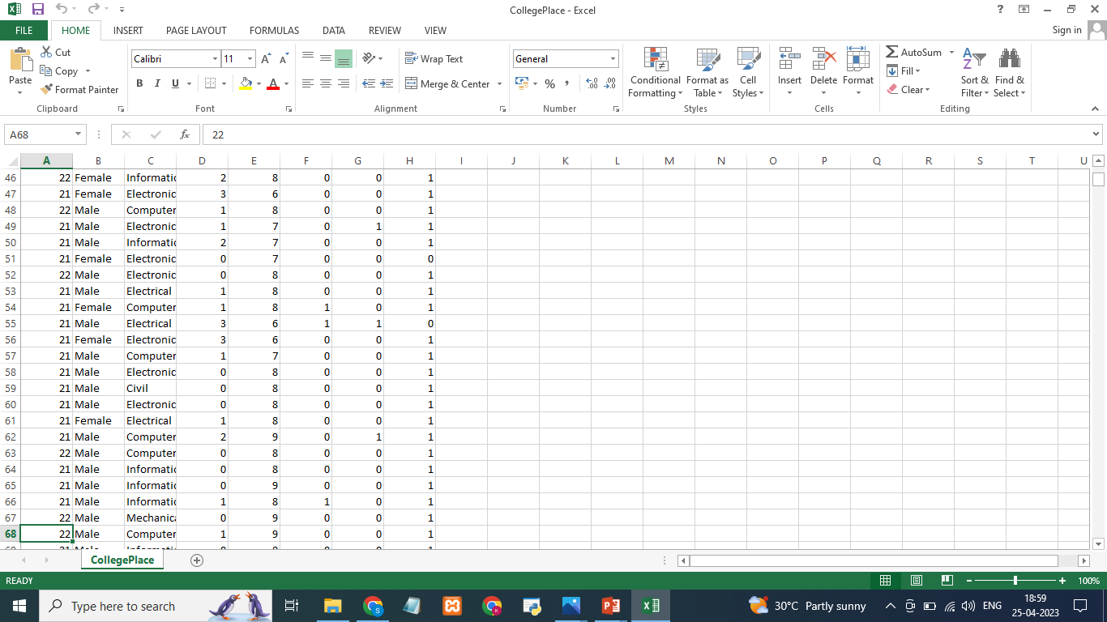
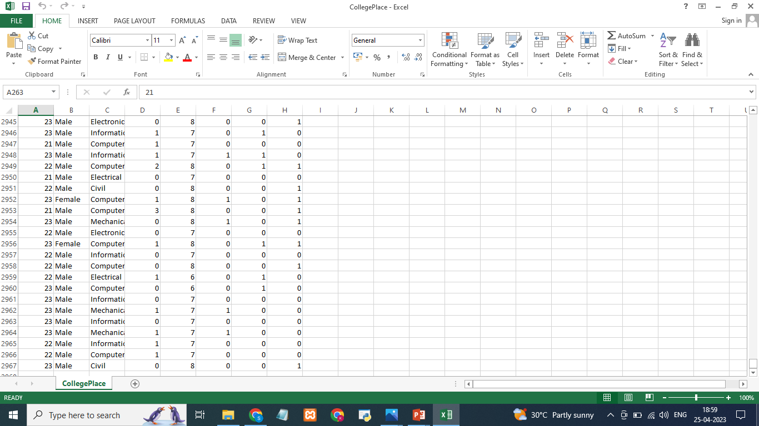

Slide 7
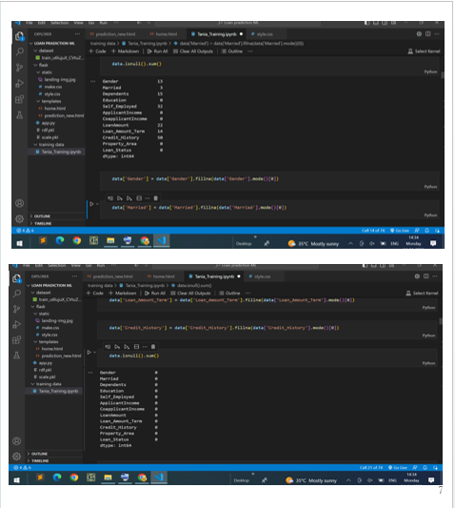
Data Preprocessing
As we have understood how the data is, let's pre-process the collected data.
The download data set is not suitable for training the machine learning model as it might have so much randomness so we need to clean the dataset properly in order to fetch good results. This activity includes the following steps.
Handling missing values
Handling categorical data
Handling Imbalance Data

Slide 8
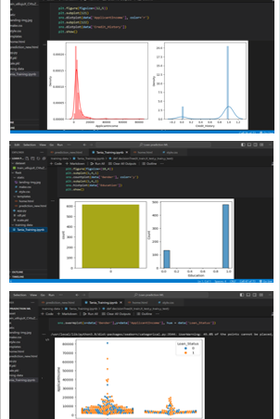
Exploratory Data Analysis
Descriptive Statistical: Descriptive analysis is to study the basic features of data with the statistical process. Here pandas has a worthy function called describe. With this describe function we can understand the unique, top and frequent values of categorical features. And we can find mean, std, min, max and percentile values of continuous features.
Visual Analysis: Visual analysis is the process of using visual representations, such as charts, plots, and graphs, to explore and understand data. It is a way to quickly identify patterns, trends, and outliers in the data, which can help to gain insights and make informed decisions.
Univariate Analysis: In simple words, univariate analysis is understanding the data with a single feature. Here we have displayed two different graphs such as distplot and countplot.
Bivariate analysis: Bivariate analysis is a statistical method that involves the analysis of the relationship between two variables. In other words, it is the study of the relationship between two variables to determine whether there is a correlation between them or not.
Multivariate Analysis: In simple words, multivariate analysis is to find the relation between multiple features. Here we have used a swarm plot from the seaborn package.

Slide 9
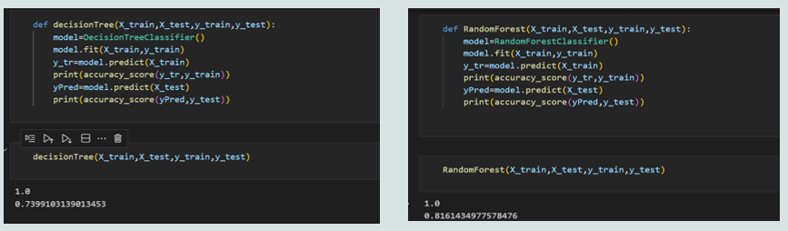
MODELSELECTION Decision Tree Model: A function named decisionTree is created and train and test data are passed as the parameters. Inside the function, DecisionTreeClassifier algorithm is initialised and training data is passed to the model with the .fit() function. Test data is predicted with .predict() function and saved in a new variable. For evaluating the model, a confusion matrix and classification report is done. Random Forest Model: A function named randomForest is created and train and test data are passed as the parameters. Inside the function, RandomForestClassifier algorithm is initialised and training data is passed to the model with .fit() function. Test data is predicted with .predict() function and saved in a new variable. For evaluating the model, a confusion matrix and classification report is done.

Slide 10
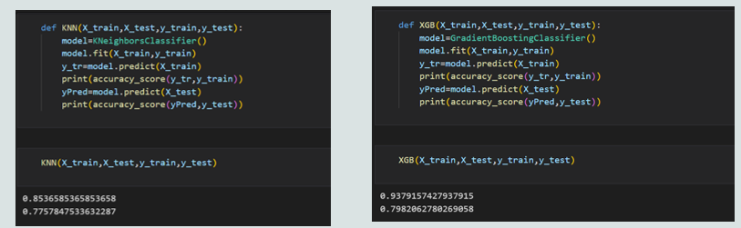
KNN Model: A function named KNN is created and train and test data are passed as the parameters. Inside the function, KNeighborsClassifier algorithm is initialised and training data is passed to the model with .fit() function. Test data is predicted with .predict() function and saved in new variable. For evaluating the model, confusion matrix and classification report is done. Xgboost Model: A function named xgboost is created and train and test data are passed as the parameters. Inside the function, GradientBoostingClassifier algorithm is initialised and training data is passed to the model with .fit() function. Test data is predicted with .predict() function and saved in new variable. For evaluating the model, confusion matrix and classification report is done. ANN Model: Building and training an Artificial Neural Network (ANN) using the Keras library with TensorFlow as the backend. The ANN is initialised as an instance of the Sequential class, which is a linear stack of layers. Then, the input layer and two hidden layers are added to the model using the Dense class, where the number of units and activation function are specified

Slide 11
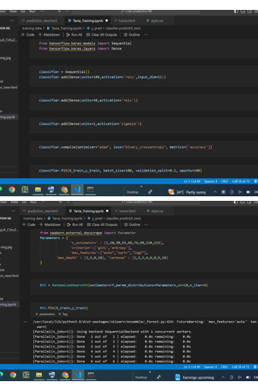
Model Evaluation
Multiple evaluation metrics means evaluating the model's performance on a test set using different performance measures. This can provide a more comprehensive understanding of the model's strengths and weaknesses. We are using evaluation metrics for classification tasks including accuracy, precision, recall, support and F1-score.

Slide 12
Conclusion
Thyroid disease is one of the diseases that afflict the world’s population, and the number of cases of this disease is increasing. Because of medical reports that show serious imbalances in thyroid diseases, our study deals with the classification of thyroid disease between hyperthyroidism and hypothyroidism. This disease was classified using algorithms. Machine learning showed us good results using several algorithms and was built in the form of two models. In the first model, all the characteristics consisting of 16 inputs and one output were taken, and the result of the accuracy of the random forest algorithm was 98.93, which is the highest accuracy among the other algorithms. In the second embodiment, the following characteristics were omitted based on a previous study. The removed attributes were 1- query_thyroxine 2- query_hypothyorid 3-query_hyperthyroid. Here we have included the increased accuracy of some algorithms, as well as the retention of the accuracy of others. It was observed that the accuracy of Naive Bayes algorithm increased the accuracy by 90.67. The highest precision of the MLP algorithm was 96.4 accuracy.

